Slide 1


User story 1:
Choosing the date
Description: Choose from the three dates.
User story 2:
Registration
Description: Clerk to enter the details of the applicant
User story 3:
Application status
Description: Accepted, rejected or waitlist.
User story 4:
Application Cancellation
Description: cancellation of application.
User story 5:
Refund
Description: Refund amount based on cancellation date.
User story 6:
Check-in
Description: Check-in of applicant after checking of all documents.

Slide 2
User story 7:
Assignment to Bunkhouses
Description : based on various factors.
User story 9:
Login
Description : registration clerk(for now).
User story 8:
Assignment to Tribes
Description : based on various factors.

Slide 3
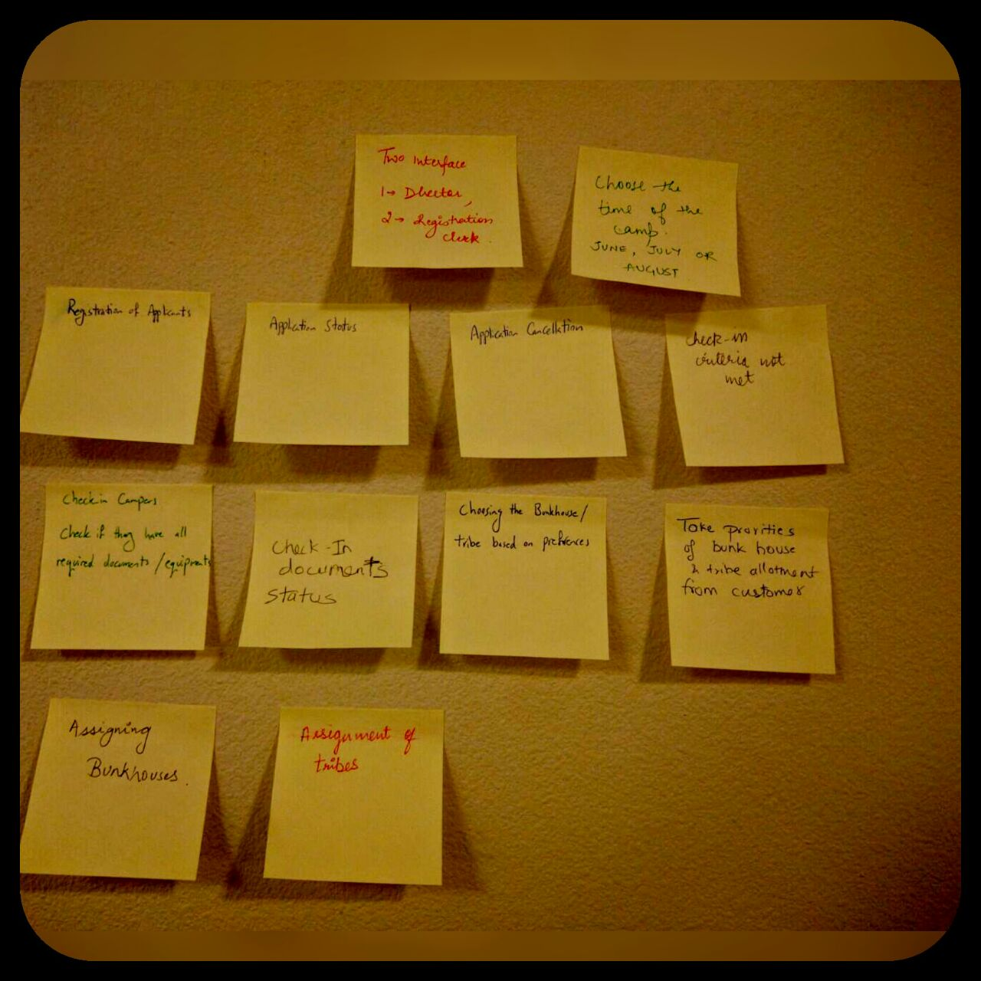

Slide 4
